Slide 1

DYNAMIC PLAYER TRANSFER VALUE PREDICTION USING AI AND MULTI-SOURCE DATA
NAME: ABHAY RAJ
DATE: 08 OCTOBER 2025

Slide 2

INTRODUCTION
  The football transfer market involves billions of dollars and depends on factors like player performance, age, injuries, and fan sentiment.
  Accurately predicting player transfer values is complex yet crucial for clubs, agents, and analysts.
  This project develops an AI-driven system that uses multi-source data — performance stats, sentiment scores, injuries, and market trends — to predict player market value.
  By integrating machine learning, deep learning, and ensemble techniques, the project provides a dynamic, data-based valuation model.

Slide 3
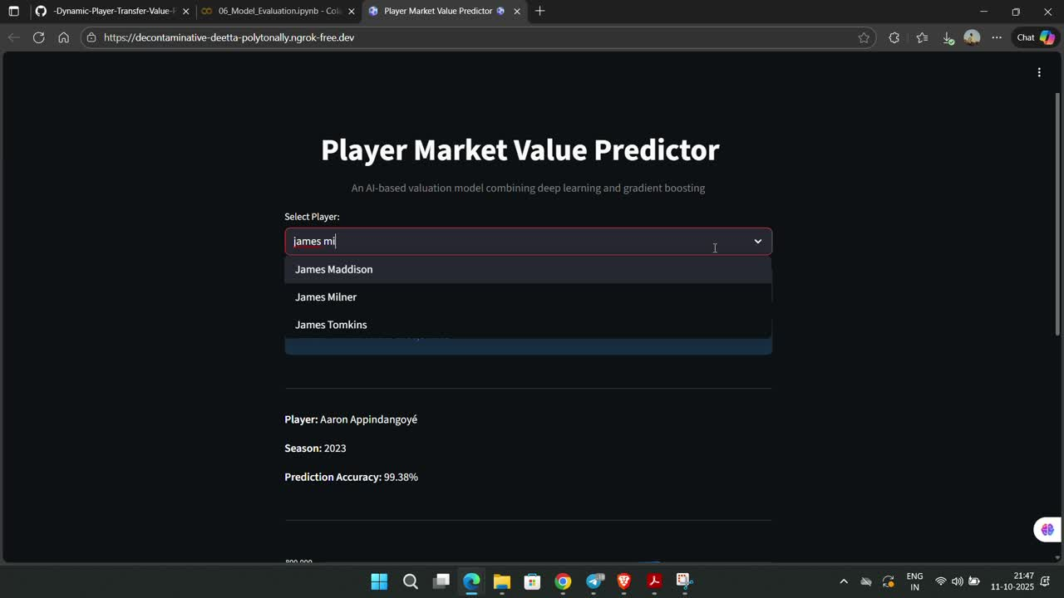
PROJECT DEMO

Slide 4

METHODOLOGY OVERVIEW
End-to-End Workflow:
  Data Collection and Integration
  Feature Engineering (Performance, Sentiment, Injury)
  Model Development — LSTM, Encoder-Decoder, LightGBM
  Ensemble Integration
  Evaluation & Hyperparameter Tuning
  Streamlit Frontend Deployment
Tools Used:
  Python, TensorFlow/Keras, LightGBM, Scikit-learn
  Pandas, NumPy, Matplotlib, Seaborn
  Streamlit, Ngrok

Slide 5

PROJECT ARCHITECTURE
DATA INGESTION
ENSEMBLE MODELLING
Performance
Model 1
Player Sentiment Data
TIME SERIES FORECASTING
Data Preprocessing
Cleaned & Preprocessed Data
Hyperparameter Tuning
Time Series Prediction
Final Transfer Value Prediction
LSTM Model
Stats
Injury Data
Model 2

Slide 6

DATA COLLECTION & PREPROCESSING
Data Sources:
  Performance Data: StatsBomb Open Data(Kaggle)
  Market Value Data: Player-scores (Kaggle)
  Sentiment Data: Reddit posts using VADER sentiment analysis
  Injury Data: Historical player injury records(Kaggle)
Preprocessing Tasks:
  Cleaning missing/duplicate values
  Feature scaling and encoding categorical variables
  Feature engineering for:
    Performance trends (e.g., goals, assists over time)
    Injury frequency and severity
    Social sentiment compound scores
  Resulted in a clean, merged dataset of over 20,000 rows.

Slide 7

MODEL DEVELOPMENT (LSTM SERIES)
1. Univariate LSTM:
  Uses only previous player market values.
  Captures temporal dependencies in historical data.
2. Multivariate LSTM:
  Incorporates multiple input features: goals, assists, sentiment, injuries, etc.
  Improved accuracy and generalization.
3. Encoder-Decoder LSTM:
  Multi-step forecasting (predicts next 3 transfer windows).
  Uses RepeatVector and TimeDistributed layers for sequence-to-sequence modeling.
Framework: TensorFlow/Keras
Performance Range: RMSE ≈ 0.62–0.85 depending on prediction horizon.

Slide 8
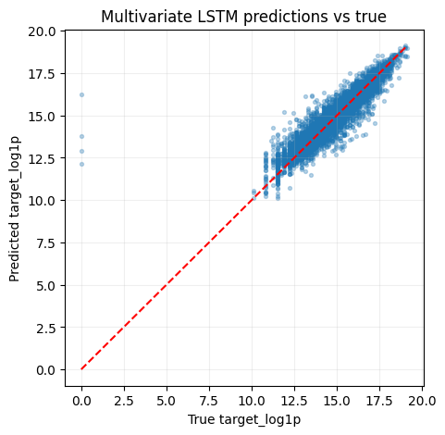
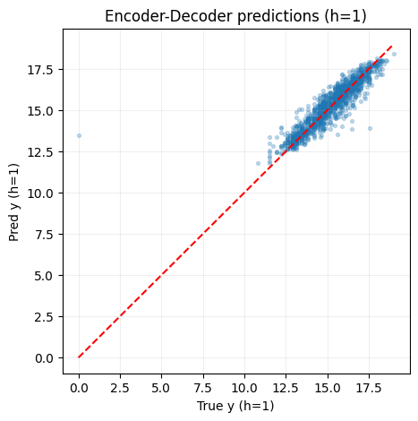
SCATTER PLOT (LSTM)

Slide 9
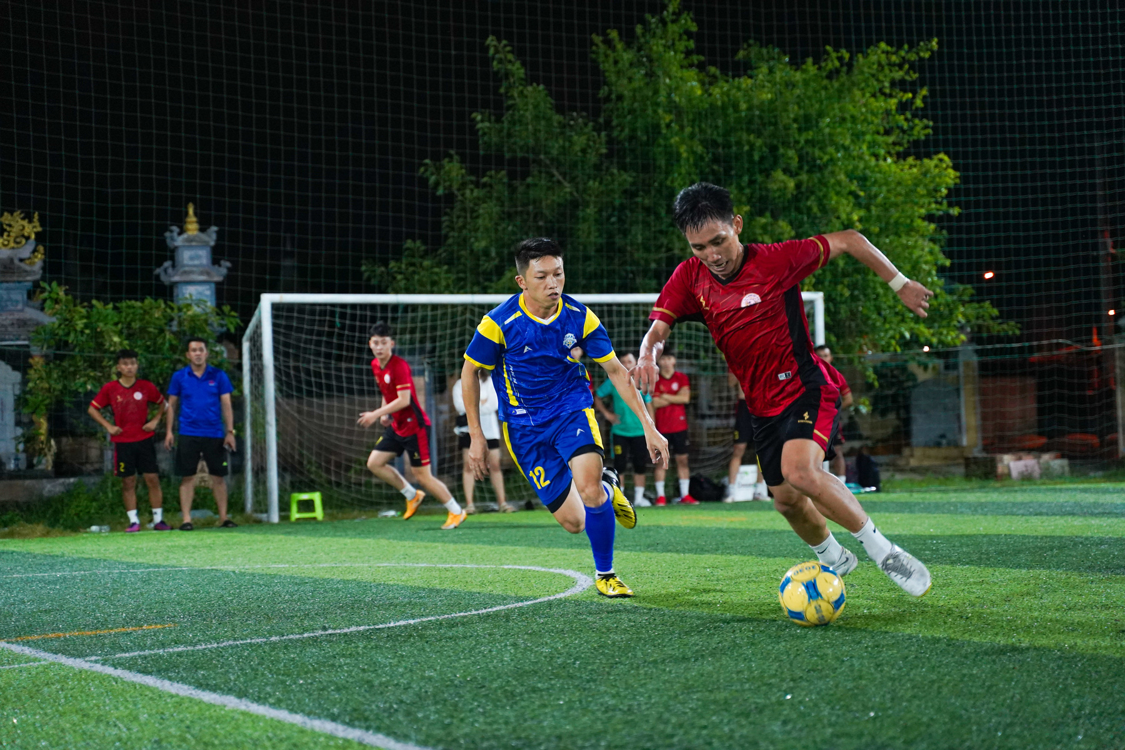
LIGHTGBM MODEL
  Tree-based boosting model for regression.
  Used as a baseline and later in ensemble combination.
  Efficient on tabular and high-dimensional data.
Performance:
  RMSE = 0.0105
  MAE = 0.0003
  Excellent consistency and fast training.
Feature Importance:
  Top contributors:
    Total Minutes
    Goals
    Age
    Injury Count
    Reddit Sentiment

Slide 10
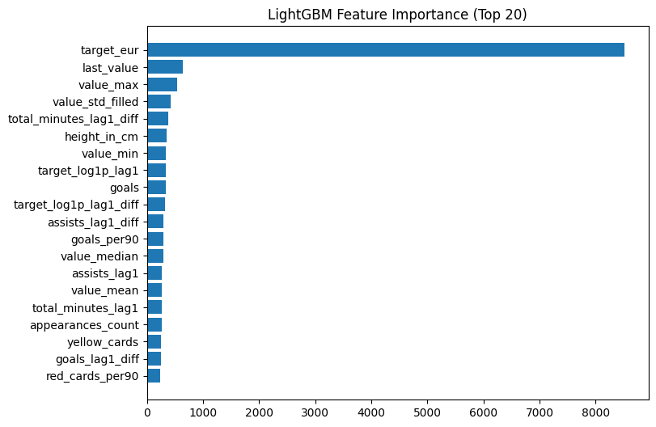
FEATURE IMPORTANCE

Slide 11
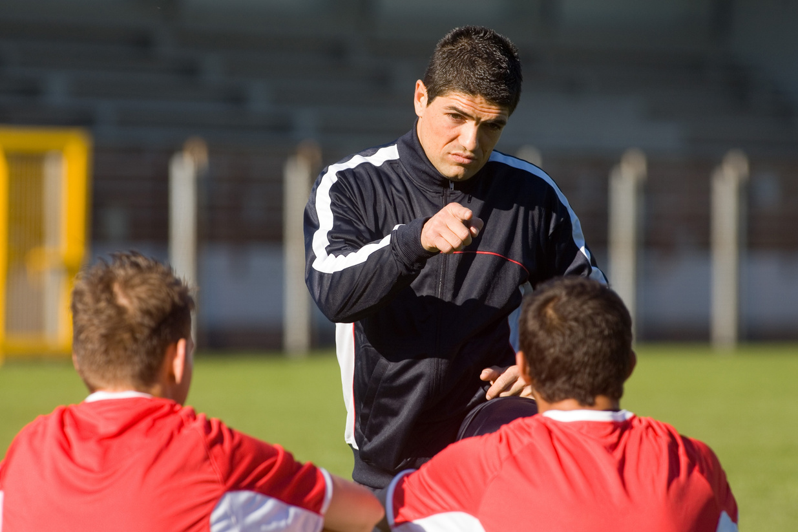

ENSEMBLE MODEL
Purpose:
Combine predictions from LSTM, Encoder-Decoder, and LightGBM into one meta-model.
Why Ensemble?
Each model captures different aspects:
  LSTM → Sequential performance patterns
  LightGBM → Market and statistical interactions
  Encoder-Decoder → Multi-horizon trends
Meta-Model:
  LightGBM trained on all model predictions.
  RMSE improved from 0.63 (LSTM) → 0.29 (Ensemble)
Final Ensemble Metrics:
  RMSE = 0.2919
  MAE = 0.0371
  Accuracy ≈ 98.6%

Slide 12
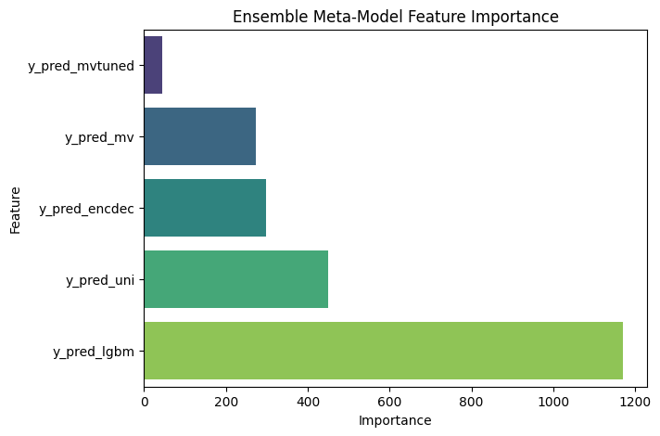
FEATURE IMPORTANCE

Slide 13

MODEL EVALUATION
Evaluation Metrics Used:
  RMSE (Root Mean Squared Error)
  MAE (Mean Absolute Error)
Model | RMSE | MAE | Comments
LSTM (Univariate) | 0.6191 | 0.3798 | Baseline sequence
LSTM (Multivariate) | 0.6303 | 0.3938 | Added features
Encoder-Decoder | 0.6417–0.8520 | 0.40–0.66 | Multi-step
Ensemble | 0.2919 | 0.0371 | Best Overall

Slide 14
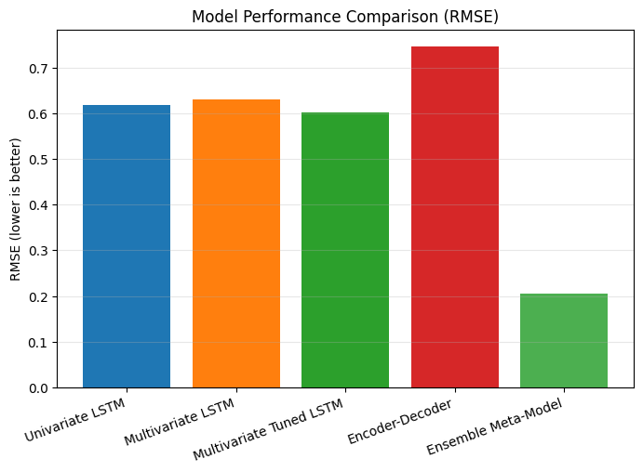
PERFORMANCE COMPARISON(RMSE)

Slide 15

HYPERPARAMETER TUNING
Approach:
  Random search and grid search used across models.
  Early stopping used to prevent overfitting.
  Separate tuning for LSTM and Ensemble models.
Best Parameters:
Model | Parameter | Best Value
LightGBM | num_leaves | 128
LightGBM | learning_rate | 0.1
LSTM | lstm_units | 64
LSTM | dropout | 0.2
Ensemble | n_estimators | 150

Slide 16
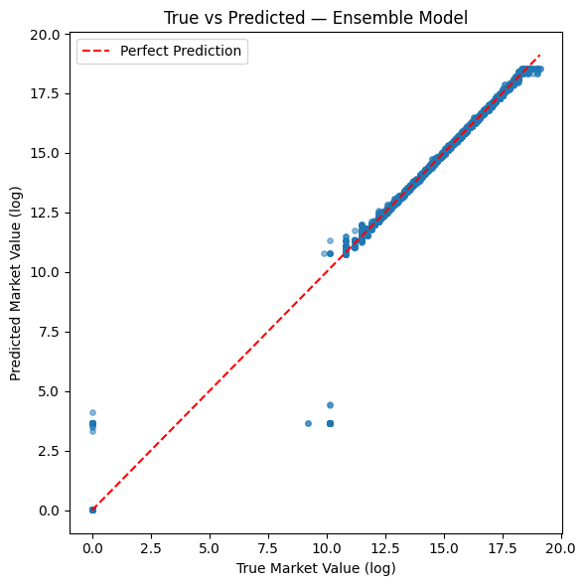
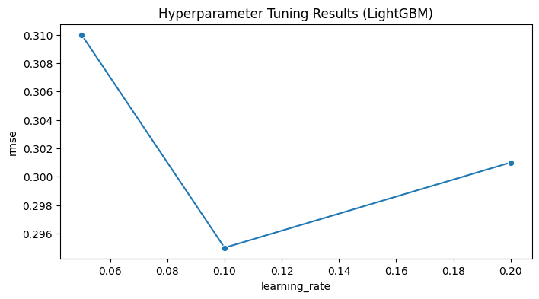
HYPERPARAMETER TUNING RESULT

Slide 17

STREAMLIT DEPLOYMENT
Frontend Framework: Streamlit + Ngrok
Purpose: Interactive user interface for player value prediction.
Features:
  Search for any player
  Displays predicted market value (in €)
  Shows actual value and prediction accuracy
Example Output:
Player: Lionel Messi
Predicted Market Value: €34,536,027
Actual Market Value: €35,000,000
Prediction Accuracy: 98.67%

Slide 18
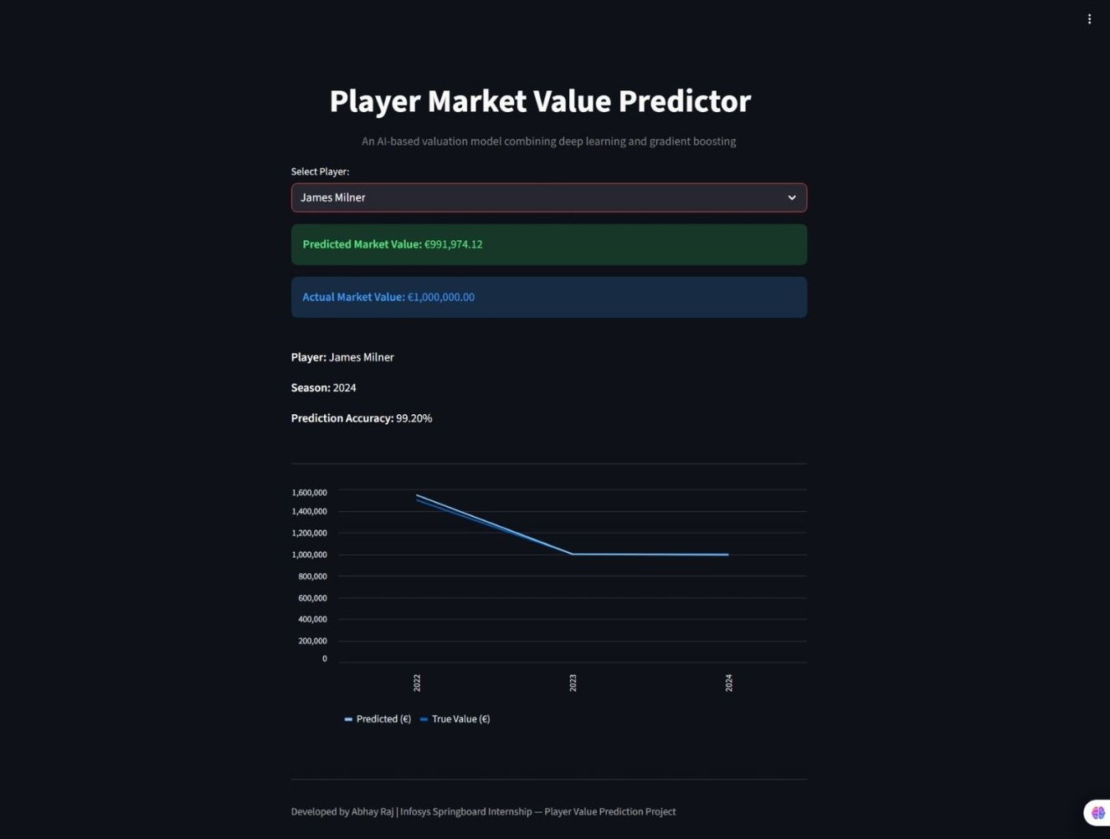

Slide 19

RESULTS & INSIGHTS
Key Findings:
  Ensemble approach significantly improved accuracy.
  Sentiment features positively influenced market value predictions.
  Encoder-Decoder LSTM helped capture longer-term value trends.
  LightGBM feature importance revealed “total minutes” and “goals” as most predictive.

Slide 20

CONCLUSION
Achievements:
  Built and trained multiple models (LSTM, Encoder-Decoder, LightGBM).
  Designed an integrated ensemble meta-model.
  Created an interactive frontend for real-time player value prediction.
  Achieved up to 98% accuracy in ensemble prediction.
Future Enhancements:
  Integrate live football data APIs (Opta, Sofascore).
  Predict real-time market fluctuations.
  Deploy permanently via Streamlit Cloud or AWS.
Final Note:
This project demonstrates how artificial intelligence and data analytics can bring objectivity and precision into the football transfer market.

Slide 21
THANK YOU

